Slide 1
Chapter 7. Classification: Advanced Methods
Feature Selection
Bayesian Belief Networks
Support Vector Machines
Rule-Based and Pattern-Based Classification
Weakly Supervised Learning
Classification with Rich Data Type
Other Related Techniques
Summary
Notes:
1

Slide 2
Feature Selection & Feature Engineering
Feature Selection
Given a set of p initial features, how to select a few most effective ones?
Why?
Irrelevant features (student ID for predicting GPA)
Redundant features (monthly income vs. yearly income)
Feature Engineering
Given the initial features, how to construct more effective ones?
# of daily positive cases, # of daily tests, # of daily hospitalization → weekly positive rate
(traditionally) domain knowledge is the key
Deep learning provides an automatic way

Slide 3
Feature Selection Methods
Filter methods
Select features based on some goodness measure
Independent of the specific classification model
Wrapper methods
Combine the feature selection and classifier model construction steps together,
Iteratively
Use the currently selected feature subset to construct a classification model
Use the current classification model to update the selected feature subset.
Embedded methods
Simultaneously constructs the classification model and selects the relevant features
Embed the feature selection step during the classification model construction step

Slide 4
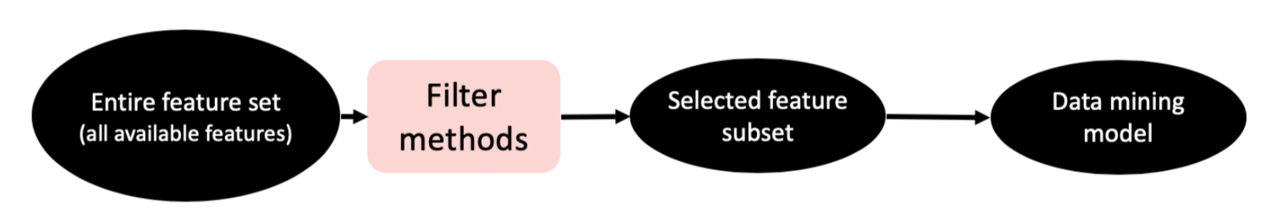
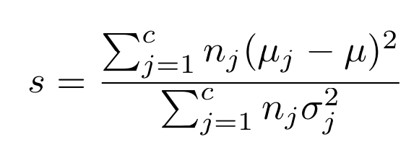
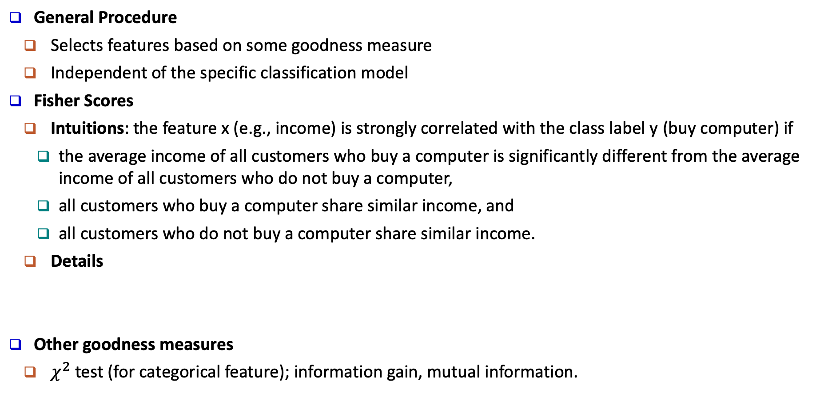
Filter Methods
General Procedure
Selects features based on some goodness measure
Independent of the specific classification model
Fisher Scores
Intuitions: the feature x (e.g., income) is strongly correlated with the class label y (buy computer) if
the average income of all customers who buy a computer is significantly different from the average income of all customers who do not buy a computer,
all customers who buy a computer share similar income, and
all customers who do not buy a computer share similar income.
Details
Other goodness measures
$χ^{2}$ test (for categorical feature); information gain, mutual information.

Slide 5
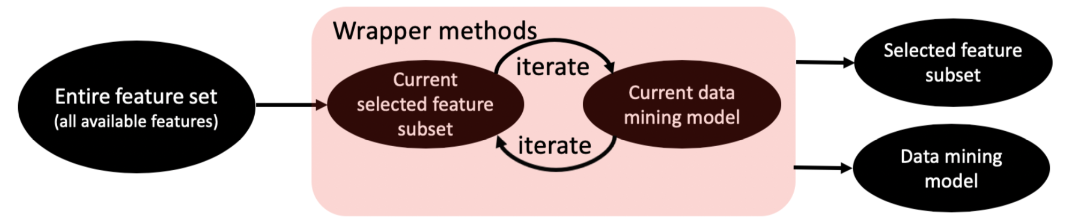
Wrapper Methods
General Procedure
Combines the feature selection and classifier model construction steps together,
Iteratively
Use the currently selected feature subset to construct a classification model
Use the current classification model to update the selected feature subset.
Key: how to search for the best feature subset
Exhaustive search: 2^{p}-1 (exponential)
Stepwise forward selection:
Start with an empty feature subset.
At each iteration, select an additional feature to improve performance most
Stepwise backward elimination: start with the full set, eliminate one feature at a time
Hybrid method

Slide 6
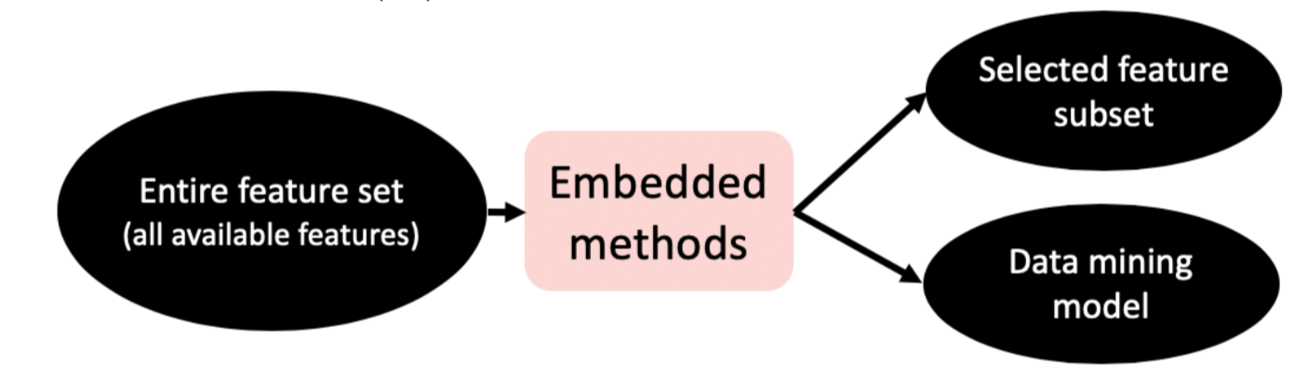

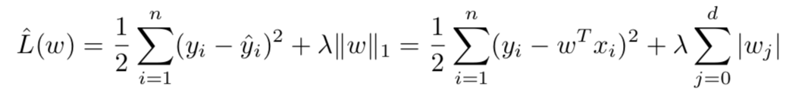
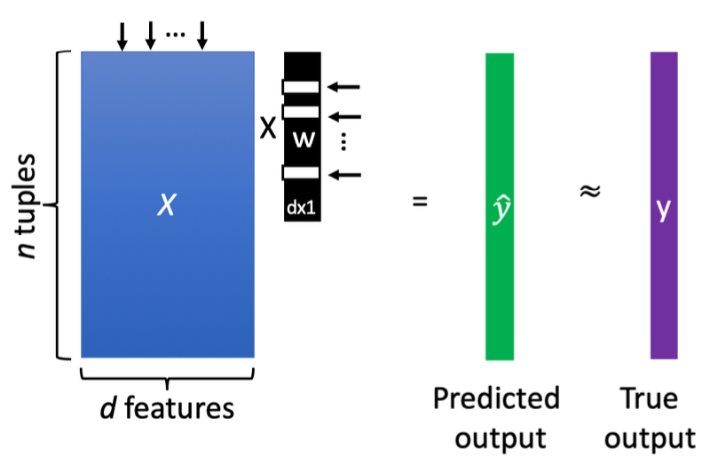
Embedded Methods
General Procedure
Simultaneously constructs the classification model and selects the relevant features
Embed the feature selection step during the classification model construction step
LASSO: Least Absolute Shrinkage and Selection Operator
Model
Training: Coordinate descent
(convex) approximation
of # of selected features
Goodness of prediction

Slide 7
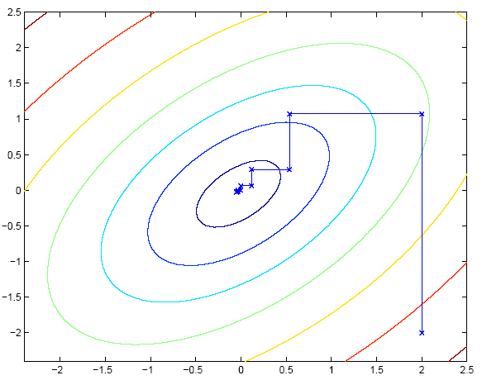
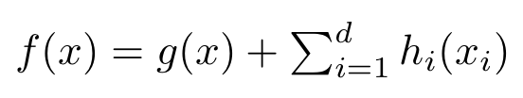
Coordinate Descent: Minimize f(x)
If f(x) is convex and smooth → global minima
If f(x) is convex but not differential → no guarantee on optimality
If f(x) is convex but not differential, but separable → global minima
g(x): convex and smooth
Each h_{i}(x): convex (but maybe non-smooth)

Slide 8
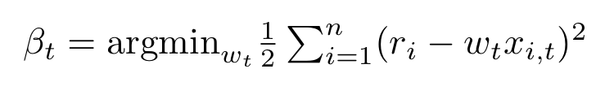
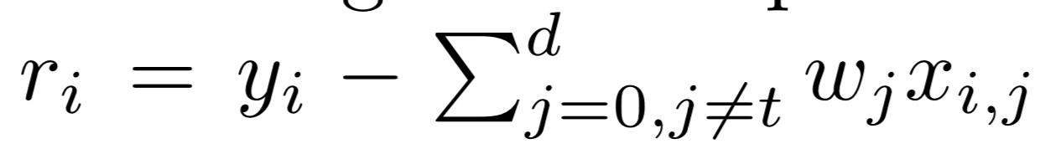
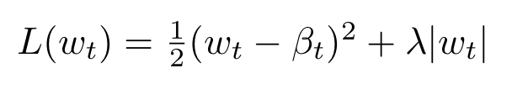

Coordinate Descent for Lasso
LASSO: Least Absolute Shrinkage and Selection Operator
Training: at each iteration, update one coefficient (w_{t}) while fixing others
Solve a least square regression problem, single dimension input (x_{i,t}) and output r
Solve the following optimization problem (quadratic, single variable)
assume each feature is normalized:

Slide 9
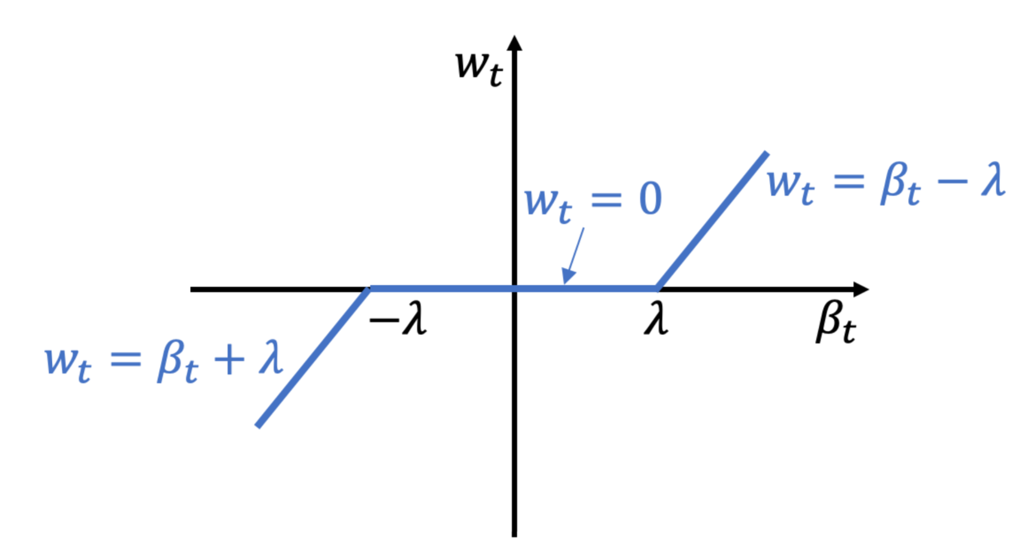
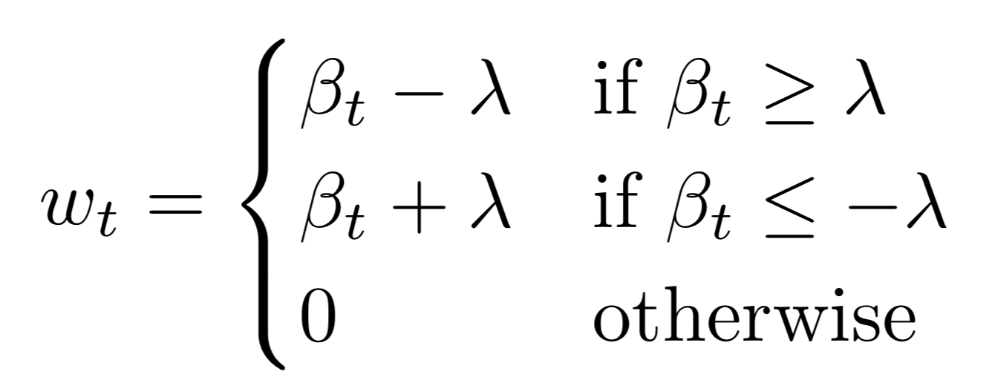

Coordinate Descent for Lasso
Solve the following optimization problem (quadratic, single variable)
Solution: soft-thresholding
Intuition: push the magnitude of toward 0

Slide 10


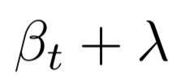



Soft Thresholding
Solve the following optimization problem (quadratic, single variable)

Slide 11
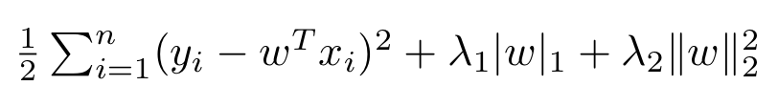
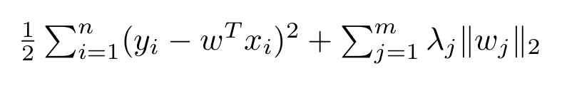
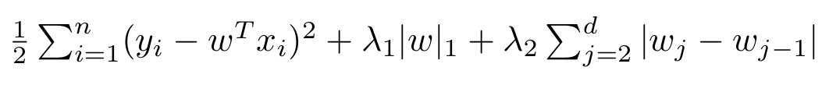
Beyond Lasso: Sparse Learning
Elastic net: L1+L2 regularization (i.e., ridge + lasso)
Group Lasso
Encourage a group of features to be unselected simultaneously
w_{j} : coefficient vector for a group of features (group j)
L₂ norm within each group; L₁ norm across groups
Fused Lasso
Encourage co-select (or co-un-select) adjacent features
Many more: e.g., graph-guided lasso, graphical lasso, matrix completion
…

Slide 12
Chapter 7. Classification: Advanced Methods
Feature Selection
Bayesian Belief Networks
Support Vector Machines
Rule-Based and Pattern-Based Classification
Weakly Supervised Learning
Classification with Rich Data Type
Other Related Techniques
Summary
Notes:
12

Slide 13
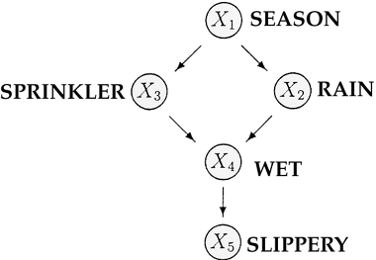
From Naïve Bayes to Bayesian Networks
Naïve Bayes classifiers assume that the value of a particular feature is independent of the value of any other feature, given the class variable
This assumption is often too simple to model the real world well
Bayesian network (or Bayes network, belief network, Bayesian model or probabilistic directed acyclic graphical model) is a probabilistic graphical model
Represented by a set of random variables and their conditional dependencies via a directed acyclic graph (DAG)
E.g. Given symptoms, the network can be used to compute the probabilities of the presence of various diseases

Slide 14

Bayesian Belief Networks
Bayesian belief network (or Bayesian network, probabilistic network):
Allows class conditional independencies between subsets of variables
Two components:
A directed acyclic graph (called a structure)
A set of conditional probability tables (CPTs)
Nodes: random variables Links: dependency
Family History
Smoker
B
B
Not Bayesian networks
Lung Cancer
Emphysema
A
C
A
C
Positive
X-Ray
Dyspnea
directed acyclic graphical model
directed cyclic graphical model
$p\left(A, B, C\right)=p$(B)$∙p(A|B)∙$p(C|A, B)
Notes:
14

Slide 15
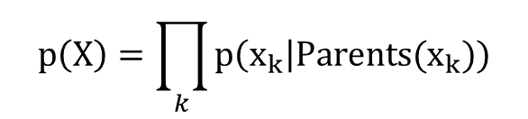
A Bayesian Network and Its CPTs
Conditional Probability Tables (CPT)
Fire | Smoke | Θ_{s|f}
True | True | .90
False | True | .01
Fire (F)
Tampering (T)
Fire | Tampering | Alarm | Θ_{a|f,t}
True | True | True | .5
True | False | True | .99
False | True | True | .85
False | False | True | .0001
Smoke (S)
Alarm (A)
CPT shows the conditional probability for each possible combination of its parents:
$$p\left(X\right)=\prod_{k}{p\left(x_{k}\right|Parents(x_{k}))}$$
$p\left(F, S ,A, T\right)=p$(F)$∙p(T)∙$p(S|F) $∙p(A|F, T)$

Slide 16
Training Bayesian Networks: Several Scenarios
Scenario 1: Given both the network structure and all variables observable: compute only the CPT entries
Scenario 2: Network structure known, some variables hidden: gradient descent (greedy hill-climbing) method, i.e., search for a solution along the steepest descent of a criterion function
Weights are initialized to random probability values
At each iteration, it moves towards what appears to be the best solution at the moment, without backtracking
Weights are updated at each iteration & converge to local optimum

Slide 17
Training Bayesian Networks: Several Scenarios
Scenario 3: Network structure unknown, all variables observable: search through the model space to reconstruct network topology
Scenario 4: Unknown structure, all hidden variables: No good algorithms known for this purpose
D. Heckerman. A Tutorial on Learning with Bayesian Networks. In Learning in Graphical Models, M. Jordan, ed. MIT Press, 1999

Slide 18



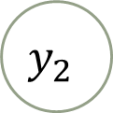


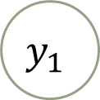

Probabilistic Graphic Model: Plate Notations
Represent variables that repeat in a graphical model
Variables
A solid (or shaded) circle means the corresponding variable is observed; otherwise it is hidden
Dependency among variables:
A Directed Acyclic Graphical (DAG) model
Using plate notation instead of flat notation
A
B
$$x$$
$$x$$
$$y_{1}$$
$$y_{2}$$
$$⋯$$
$$y_{N}$$
$$y$$
$$N$$
Flat notation
Plate notation

Slide 19
An Example of Plate Notation
Flat notation
Grade for (course0, student a)
Difficulty for Course 0
Plate notation
Grade for (course0, student b)
Difficulty for Course 1
Difficulty
Grade for (course1, student a)
#Courses
Intelligence for student a
Grade
Grade for (course1, student b)
#Grades
Intelligence
Intelligence for student b
#Students
Grade for (course1, student c)
Intelligence for student c

Slide 20
Chapter 7. Classification: Advanced Methods
Feature Selection
Bayesian Belief Networks
Support Vector Machines
Rule-Based and Pattern-Based Classification
Weakly Supervised Learning
Classification with Rich Data Type
Other Related Techniques
Summary
Notes:
20

Slide 21
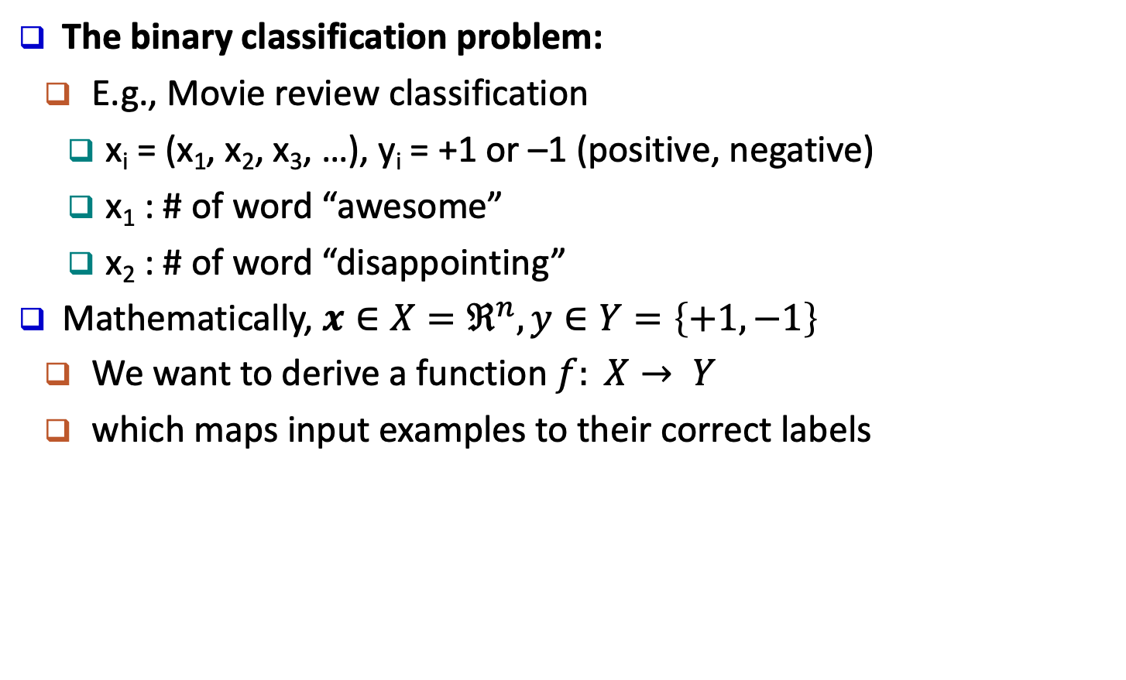
Classification: A Mathematical Mapping
The binary classification problem:
E.g., Movie review classification
x_{i} = (x₁, x₂, x₃, …), y_{i} = +1 or –1 (positive, negative)
x₁ : # of word “awesome”
x₂ : # of word “disappointing”
Mathematically, $x∈X=ℜ^{n},y∈Y=\left\{+1,−1\right\}$
We want to derive a function $f: X→ Y$
which maps input examples to their correct labels
Notes:
21

Slide 22
SVM—Support Vector Machines
linear and nonlinear
Vapnik and colleagues (1992)—groundwork from Vapnik & Chervonenkis’ statistical learning theory in 1960s
It uses a nonlinear mapping to transform the original training data into a higher dimension
With the new dimension, it searches for the linear optimal separating hyperplane (i.e., “decision boundary”)
With an appropriate nonlinear mapping to a sufficiently high dimension, data from two classes can always be separated by a hyperplane
SVM finds this hyperplane using support vectors (“essential” training tuples) and margins (defined by the support vectors)

Slide 23
SVM—General Philosophy
Learning a max-margin classifier
From the infinite set of lines (hyperplanes) separating two classes
Find the one which separates two classes with the largest margin
i.e. a maximum marginal hyperplane (MMH)

Slide 24
SVM—When Data Is Linearly Separable
Linearly Separable
Linearly Inseparable
The simplest case: When data is linearly separable
Data sets whose classes can be separated exactly by linear decision surfaces are said to be linearly separable

Slide 25
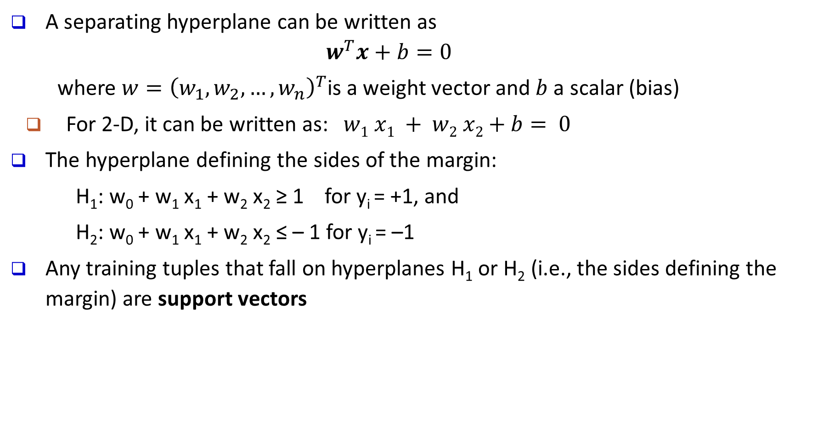
Linear SVM for Linearly Separable Data
A separating hyperplane can be written as
$$w^{T}x+b=0$$
where $w={\left(w_{1},w_{2},…,w_{n}\right)}^{T}$is a weight vector and $b$ a scalar (bias)
For 2-D, it can be written as: $w1 x1 + w2 x2+b= 0$
The hyperplane defining the sides of the margin:
H₁: w₀ + w₁ x₁ + w₂ x₂ ≥ 1 for y_{i} = +1, and
H₂: w₀ + w₁ x₁ + w₂ x₂ ≤ – 1 for y_{i} = –1
Any training tuples that fall on hyperplanes H₁ or H₂ (i.e., the sides defining the margin) are support vectors
Model parameters to learn

Slide 26
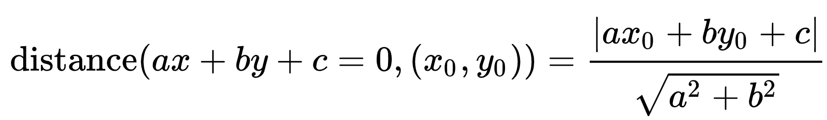
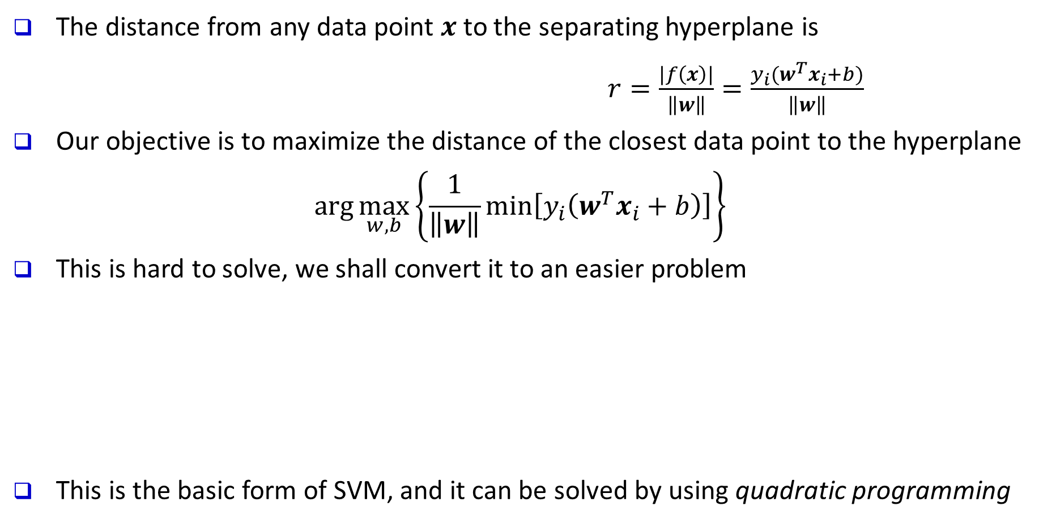
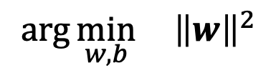
Linear SVM for Linearly Separable Data
The distance from any data point $x$ to the separating hyperplane is
$r=\frac{|f\left(x\right)|}{\left\|w\right\|}=\frac{y_{i}(w^{T}x_{i}+b)}{\left\|w\right\|}$
Our objective is to maximize the distance of the closest data point to the hyperplane
$$\arg{\max_{w,b}\left\{\frac{1}{\left\|w\right\|}\min\left[y_{i}\left(w^{T}x_{i}+b\right)\right]\right\}}$$
This is hard to solve, we shall convert it to an easier problem
This is the basic form of SVM, and it can be solved by using quadratic programming
$$\arg{\min_{w,b}{ {\left\|w\right\|}^{2}}}$$
$${s.t. y}_{i}\left(w^{T}x_{i}+b\right)≥1, i=1,2,…,n$$

Slide 27






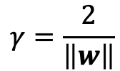
Linear SVM for Linearly Separable Data
$$x_{2}$$
$w^{T}x_{i}+b=0$
The data points closest to the separating hyperplane are called support vectors
$w^{T}x_{i}+b=1$
$w^{T}x_{i}+b=−1$
$$γ=\frac{2}{\left\|w\right\|}$$
“Margin”
$$0$$
$$x_{1}$$

Slide 28
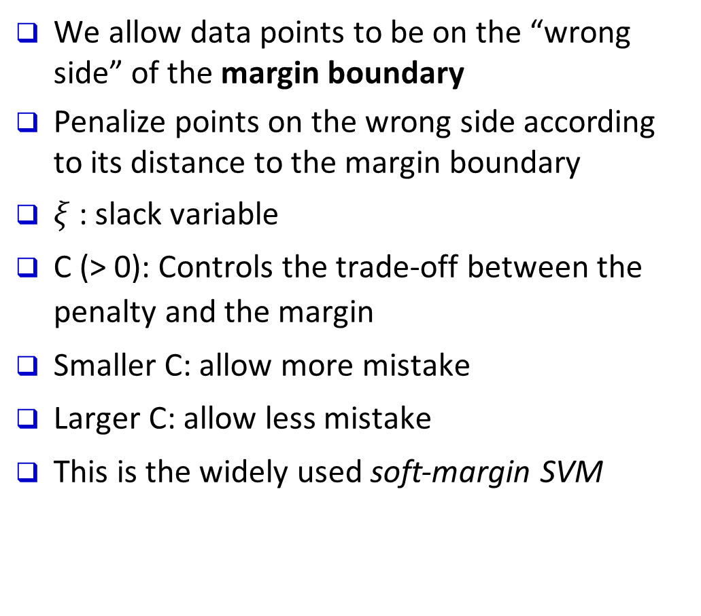




SVM for Linearly Inseparable Data
We allow data points to be on the “wrong side” of the margin boundary
Penalize points on the wrong side according to its distance to the margin boundary
$ξ$: slack variable
C (> 0): Controls the trade-off between the penalty and the margin
Smaller C: allow more mistake
Larger C: allow less mistake
This is the widely used soft-margin SVM
$$ξ>1$$
$$ξ=0$$
$$ξ<1$$
$$ξ=1$$

Slide 29
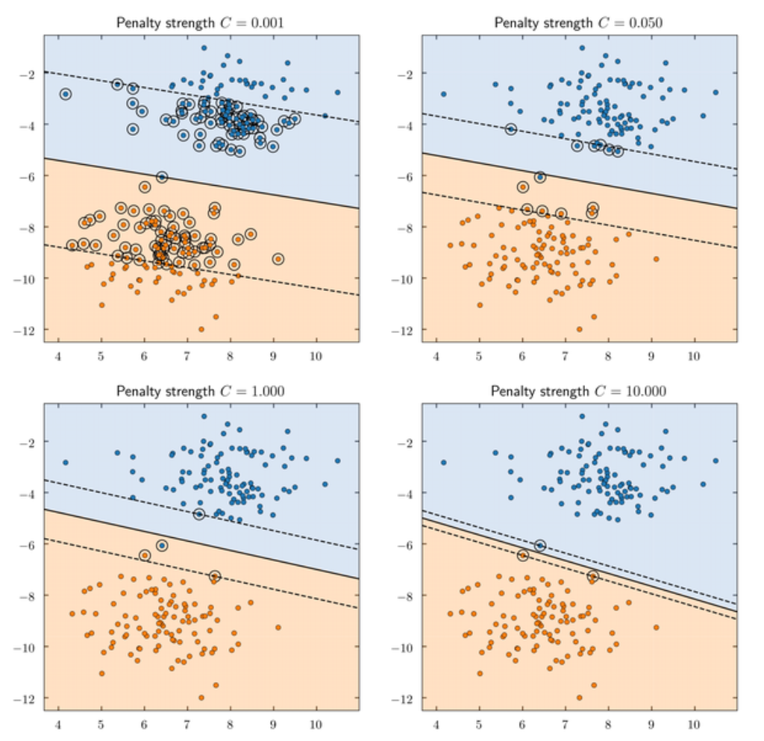
Effect of slack variable
https://www.quora.com/What-is-the-purpose-for-using-slack-variable-in-SVM

Slide 30

SVM for Linearly Inseparable Data
Alternatively, for linearly inseparable data, we can map them to a higher dimensional space
We search for a linear separating hyperplane in the new space
Example: The XOR problem
$$x⟼φ(x)$$

Slide 31
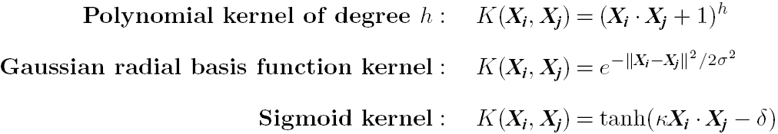
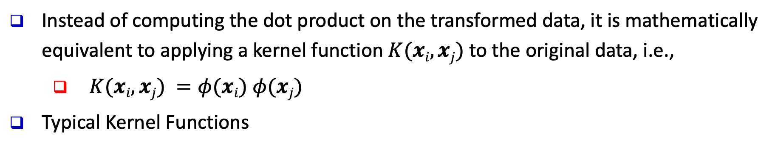
Kernel Functions for Nonlinear Classification
Instead of computing the dot product on the transformed data, it is mathematically equivalent to applying a kernel function $K(xi, xj)$to the original data, i.e.,
$K(xi, xj) =φ(xi) φ(xj)$
Typical Kernel Functions
SVMs can efficiently perform a non-linear classification using kernel functions, implicitly mapping their inputs into high-dimensional feature spaces
https://www.youtube.com/watch?time_continue=42&v=3liCbRZPrZA
http://crsouza.com/2010/03/17/kernel-functions-for-machine-learning-applications/

Slide 32
Multi-class Classification with SVM
One-vs-Rest
Requires N classifiers
N classes
One-vs-One
Requires N(N - 1)/2 classifiers

Slide 33
Is SVM Scalable on Massive Data?
SVM is effective on high dimensional data
The complexity of trained classifier is characterized by the # of support vectors rather than the dimensionality of the data
The support vectors are the essential or critical training examples—they lie closest to the decision boundary (MMH)
Thus, an SVM with a small number of support vectors can have good generalization, even when the dimensionality of the data is high
SVM is not scalable to the # of data objects in terms of training time and memory usage
Scaling SVM by a hierarchical micro-clustering approach
H. Yu, J. Yang, and J. Han, “Classifying Large Data Sets Using SVM with Hierarchical Clusters”, KDD'03

Slide 34
SVM: Applications
Features: training can be slow but accuracy is high owing to their ability to model complex nonlinear decision boundaries (margin maximization)
Used for: classification and numeric prediction
SVM can also be used for classifying multiple (> 2) classes and for regression analysis (with additional parameters)
Applications:
handwritten digit recognition, object recognition, speaker identification, benchmarking time-series prediction tests

Slide 35
SVM Recap
Pros
Elegant mathematical formulation, guaranteed global optimal with optimization
Trains well on small data sets
Flexibility through kernel functions
Conformity with semi-supervised training
Cons
Not naturally scalable to large data sets

Slide 36
SVM Related Links
SVM Website: http://www.kernel-machines.org/
Representative implementations
LIBSVM: an efficient implementation of SVM, multi-class classifications, nu-SVM, one-class SVM, including also various interfaces with java, python, etc.
SVM-light: simpler but performance is not better than LIBSVM, support only binary classification and only in C
SVM-torch: another recent implementation also written in C

Slide 37
SVM Related Links
SVM Website: http://www.kernel-machines.org/
Representative implementations
LIBSVM: an efficient implementation of SVM, multi-class classifications, nu-SVM, one-class SVM, including also various interfaces with java, python, etc.
SVM-light: simpler but performance is not better than LIBSVM, support only binary classification and only in C
SVM-torch: another recent implementation also written in C

Slide 38
Chapter 7. Classification: Advanced Methods
Feature Selection
Bayesian Belief Networks
Support Vector Machines
Rule-Based and Pattern-Based Classification
Weakly Supervised Learning
Classification with Rich Data Type
Other Related Techniques
Summary
Notes:
38

Slide 39
Using IF-THEN Rules for Classification
Represent the knowledge in the form of IF-THEN rules
R₁: IF age = youth AND student = yes THEN buys_computer = yes
Assessment of a rule: coverage and accuracy
coverage(R₁) = ratio of tuples covered by the condition of R₁ (THEN-part is not important for this)
accuracy(R₁) = ratio of tuples correctly classified by R₁ in the covered ones (both IF-part and THEN-part counts)
If more than one rule are triggered, need conflict resolution
Size ordering: assign the highest priority to the triggering rules that has the “toughest” requirement (i.e., with the most attribute tests)
Class-based ordering: decreasing order of prevalence or misclassification cost per class
Rule-based ordering (decision list): rules are organized into one long priority list, according to some measure of rule quality or by experts

Slide 40
Rule Extraction from a Decision Tree
Rules are easier to understand than large trees
One rule is created for each path from the root to a leaf
Each attribute-value pair along a path forms a conjunction: the leaf holds the class prediction
Rules are mutually exclusive and exhaustive
age?
<=30
31..40
>40
student?
credit rating?
yes
no
yes
excellent
fair
no
yes
no
yes
Example: Rule extraction from our buys_computer decision-tree
IF age = young AND student = no THEN buys_computer = no
IF age = young AND student = yes THEN buys_computer = yes
IF age = mid-age THEN buys_computer = yes
IF age = old AND credit_rating = excellent THEN buys_computer = no
IF age = old AND credit_rating = fair THEN buys_computer = yes

Slide 41
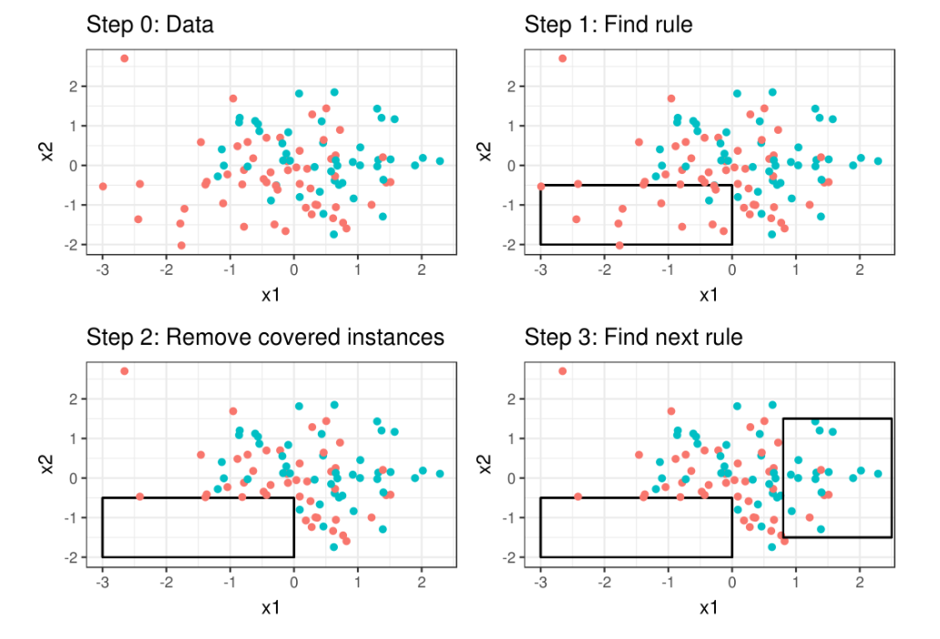
Rule Induction: Sequential Covering Method
Sequential covering algorithm: Extracts rules directly from training data
Rules are learned sequentially, each for a given class C_{i} will cover many tuples of C_{i} but none (or few) of the tuples of other classes
Comp. w. decision-tree induction: learning a set of rules simultaneously
Step 0: Start with an empty list of rules.

Slide 42
Rule Induction: Sequential Covering Method
Sequential covering algorithm: Extracts rules directly from training data
Rules are learned sequentially, each for a given class C_{i} will cover many tuples of C_{i} but none (or few) of the tuples of other classes
Comp. w. decision-tree induction: learning a set of rules simultaneously
Step 1: Learn a rule r.

Slide 43
Rule Induction: Sequential Covering Method
Sequential covering algorithm: Extracts rules directly from training data
Rules are learned sequentially, each for a given class C_{i} will cover many tuples of C_{i} but none (or few) of the tuples of other classes
Comp. w. decision-tree induction: learning a set of rules simultaneously
Step 2: The tuples covered by the rules are
removed.

Slide 44
Rule Induction: Sequential Covering Method
Sequential covering algorithm: Extracts rules directly from training data
Rules are learned sequentially, each for a given class C_{i} will cover many tuples of C_{i} but none (or few) of the tuples of other classes
Comp. w. decision-tree induction: learning a set of rules simultaneously
Step 3: Repeat the process on the remaining
tuples until termination condition, e.g., when
no more training examples or when the quality
of a rule returned is below a threshold.

Slide 45
Pattern-Based Classification, Why?
Frequent Pattern
Mining
Pattern-Based
Classification
Classification
Pattern-based classification: An integration of both themes
Why pattern-based classification?
Feature construction
Higher order; compact; discriminative
E.g., single word → phrase (Apple pie, Apple i-pad)
Complex data modeling
Graphs (no predefined feature vectors)
Sequences
Semi-structured/unstructured Data

Slide 46
CBA: Classification Based on Associations
CBA [Liu, Hsu and Ma, KDD’98]
Method
Mine high-confidence, high-support class association rules
LHS: conjunctions of attribute-value pairs); RHS: class labels
p₁ ^ p₂ … ^ p_{l} → “A_{class-label} = C” (confidence, support)
Rank rules in descending order of confidence and support
Classification: Apply the first rule that matches a test case; o.w. apply the default rule
Effectiveness: Often found more accurate than some traditional classification methods, such as C4.5
Why? — Exploring high confident associations among multiple attributes may overcome some constraints introduced by some classifiers that consider only one attribute at a time

Slide 47
Chapter 7. Classification: Advanced Methods
Feature Selection
Bayesian Belief Networks
Support Vector Machines
Rule-Based and Pattern-Based Classification
Weakly Supervised Learning
Classification with Rich Data Type
Other Related Techniques
Summary
Notes:
47

Slide 48
Weakly Supervised Learning
Semi-supervised learning
Active learning
Transfer learning
Distant supervision
Zero-shot learning
Notes:
48

Slide 49
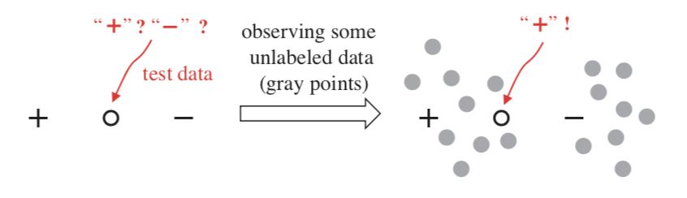
Semi-supervised Learning
Goal: uses labeled data and unlabeled data to build a classifier

Slide 50
SSL: Self-training
General procedure
Select a learning method such as Bayesian classification.
Build the classifier using the labeled data.
Use the classifier to label the unlabeled data.
Select the unlabeled tuple having the highest confidence.
Add it and its predicted label to label set.
Repeat

Slide 51
SSL: Co-training
General procedure
Define two separate non-overlapping feature sets for the labeled data
Train two classiers, f₁ and f₂, on the labeled data, each trained on one feature set.
Classify un-labeled tuples by f₁ and f₂ separately.
Select the unlabeled tuple having the highest confidence by f₁ and add it to the labeled set for f₂
Select the unlabeled tuple having the highest confidence by f₂ and add it to the labeled set for f₁
Repeat

Slide 52
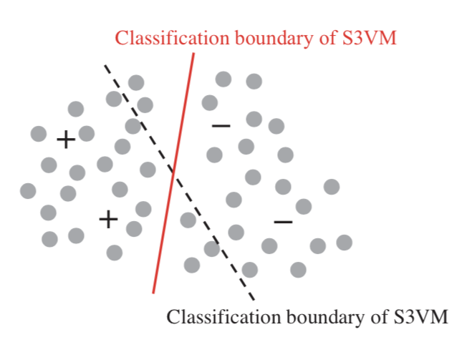
When does SSL Work? -- Clustering Assumption
Data tuples from same cluster are likely to share same label
An example: S3VM
Seeking a max-margin hyperplane (same as SVM)
avoiding to disrupt the clustering structure of unlabeled tuples
E.g. go through low-density region of unlabeled data

Slide 53
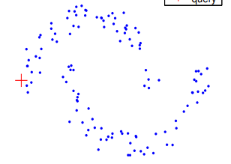
When does SSL Work? -- Manifold Assumption
A pair of close tuples are likely to share the same class label
An example: graph-based SSL
_

Slide 54
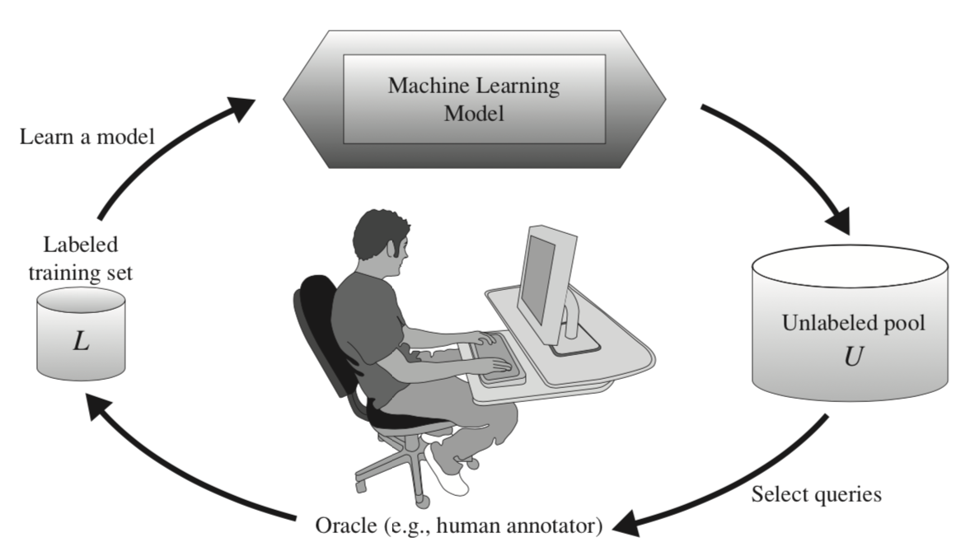
Active Learning
Goal: find ‘the best’ unlabeled data samples to ask the oracle for their labels, so as to maximally improve the classification performance.
Pool-based active learning
Key: how to choose the data tuples to be queried
Uncertainty sampling
Query-by-committee
Version space
Decision-theoretic approach

Slide 55
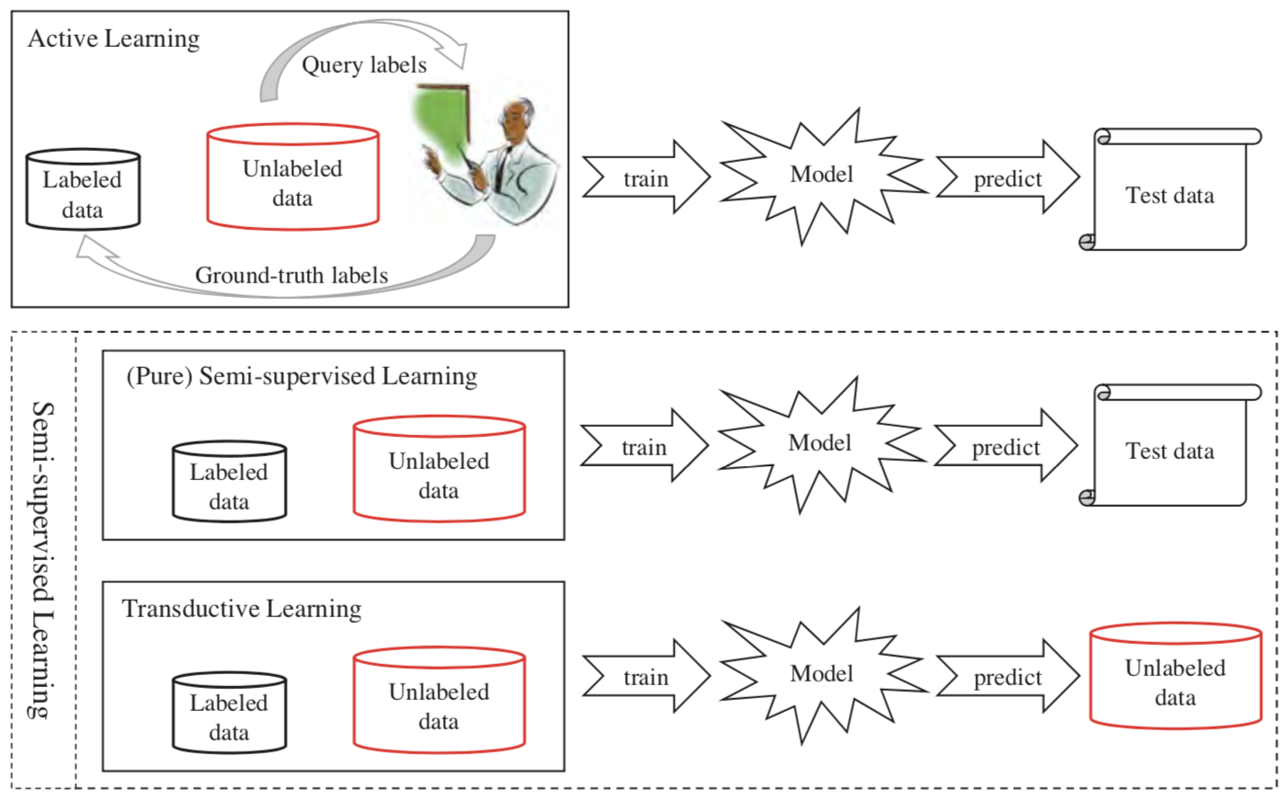
Active Learning vs. SSL (vs. transductive learning)
Notes:
Figure credit: Zhi-Hua Zhou: A Brief Introduction to Weakly Supervised Learning

Slide 56
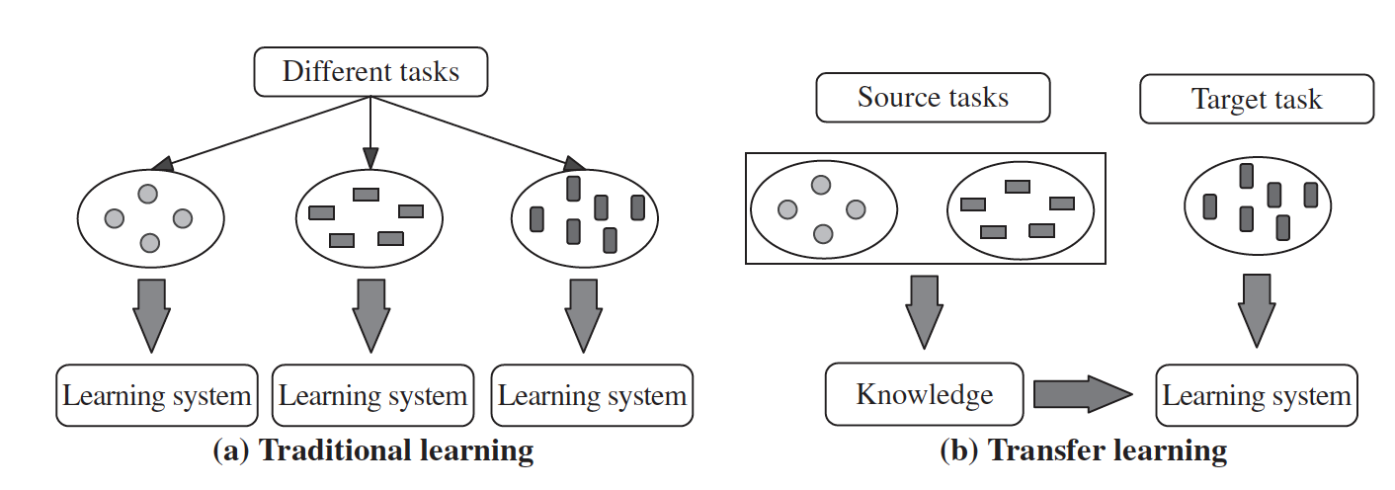
Transfer Learning
Goal: aims to extract the knowledge from one or more source tasks and apply the knowledge to a target task
An example
Source task: review sentiment classification on electronics
Target task: review sentiment classification on movies

Slide 57
TrAdaBoost
General strategy: Instance-based transfer learning: reweight some of the data from the source task and uses it to learn the target task.
Intuition: `transfer’ most relevant/similar data from source to target
Details
Boosting: each base learner pays more attention to difficult training examples (e.g., misclassified by the previous base learner)
TrAdaBoost: if a source tuple is misclassified, reduce its weight (e.g., not very relevant to the target task)
Key challenge in transfer learning: negative transfer
Quantify the difference between the source and target tasks
Transfer margin, divergence metric
Related problems
Multi-task learning; pre-training + fine-tuning

Slide 58
Distant Supervision
Goal: automatically generate a large number of labelled tuples.
Characteristic of the generated labels
Noisy, but large in volume
Example #1: Twitter sentiment classification (positive vs. negative)
if a tweet contains :-), treat it as a positive tuple
If a tweet contains :-(, treat it as a negative tuple
Example #2: Twitter category classification (e.g., news, health, science, games, etc.)
If a tweet contains a URL, use the ODP (open directory project) category of the URL as the label of the tweet
If a tweet contains a Youtube video link, treat the label of Youtube video as the label of the tweet

Slide 59
Distant Supervision
Applications
Social media post classification
Relation extraction for NLP
Active research area: how to obtain labeling function
Main Challenge: noisy labels
:) in a tweet post could have neutral or even negative sentiment

Slide 60
Zero-shot Learning
A motivating example:
A trained classifier to classify an animal image into owl vs. dog vs. fish.
But, the test image is actually about cat.
Goal: predict a test tuple whose class label was never observed during the training stage
General strategies: leverage external knowledge or side information
Applications:
Image recognition
Neural activity recognition
Graph anomaly detection
Generalized zero-shot learning: the test image might come from known or novel classes

Slide 61
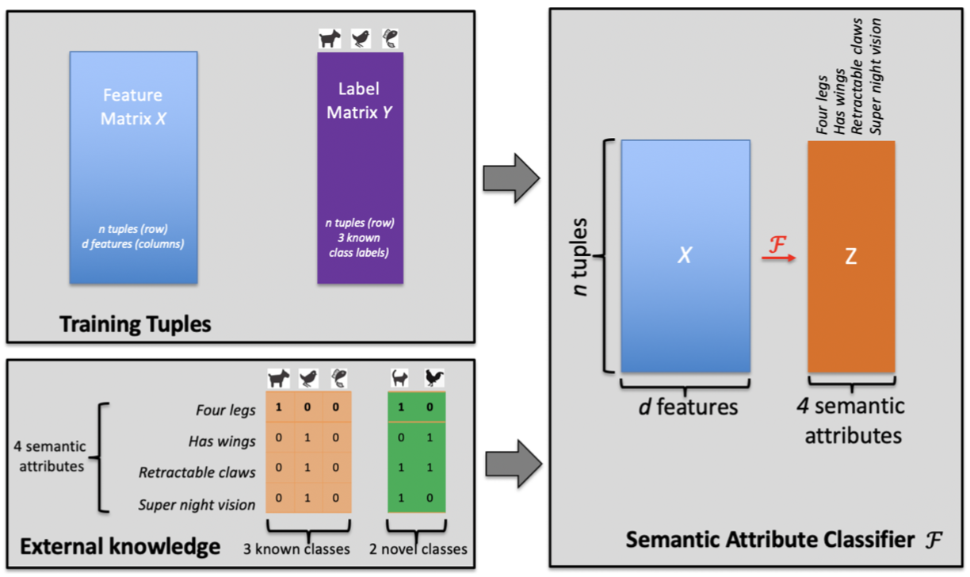
Semantic attribute classifier
Details
Use the training tuples to build semantic attribute classifier
Use the semantic attribute classifier to infer semantic attributes
Use the semantic attributes to predict the novel class
Key Idea: leverage the semantic attributes to transfer the output of the semantic classier

Slide 62
Chapter 7. Classification: Advanced Methods
Feature Selection
Bayesian Belief Networks
Support Vector Machines
Rule-Based and Pattern-Based Classification
Weakly Supervised Learning
Classification with Rich Data Type
Other Related Techniques
Summary
Notes:
62

Slide 63
Classification with Rich Data Type
Stream Data Classification
Sequence Classification
Graph Data Classification
Notes:
63

Slide 64
Stream Data Classification
A motivating example:
Data mining tool to detect fraudulent transaction
the transactions arrive sequentially at different times in a stream fashion
Training set → build classification model → receiving new data → retraining …
Challenges:
High arrival speed
Infinite length
One-pass constraint
Concept drifting

Slide 65
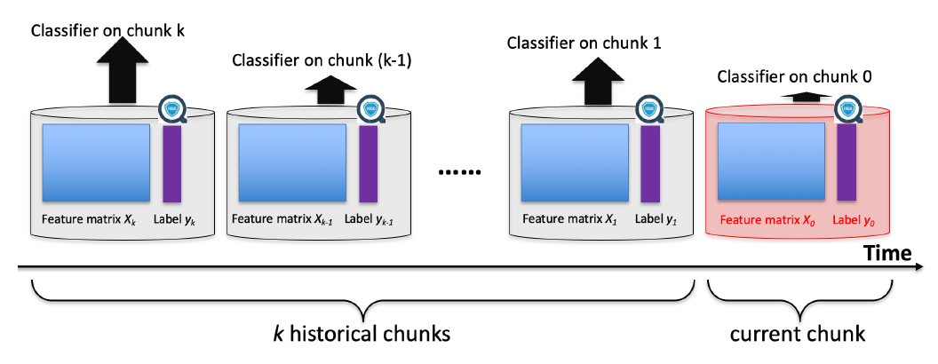
Stream Data Classification via Ensemble
Key Ideas:
Only use the most recent chunk to train the new classifier → high arrival rate of the stream data.
Each incoming data tuple is accessed once to train the current classifier as well as to update the weights of individual classifiers --> one pass constraint.
Adjust the weights of the individual classifiers to pay more attention to the most relevant chunks → captures the drifted class concept over time.

Slide 66
Stream Data Classification
Other applications
Marketing
Network monitoring
Sensor networks
VFDT: very fast decision tree
Hoeffding trees: build the decision tree by using a sampled subset of training tuples,
Sliding window mechanism to obtain classifier to focus on the most recent stream data.

Slide 67

Sequence Classification
Sequence: an ordered list of values
A sentence
A DNA segment
List of transactions of a customer over time
Sequence Classification: build a classifier to predict the label of a given sequence
the positive vs. negative sentiment of the sentence in NLP
the gene coding area vs. non-coding area in genomic analysis,
high-value vs. ordinary customer in market analysis.
Other forms of sequence classification: predict label for each time stamp

Slide 68
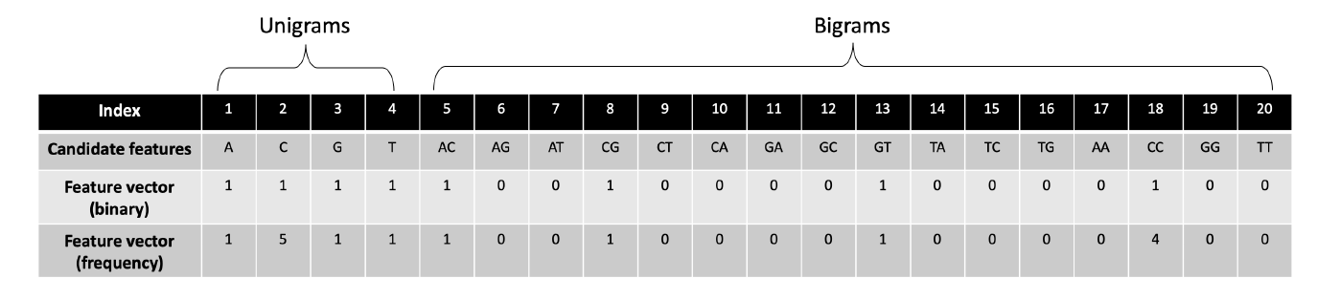
Sequence Classification via Feature Engineering
General Ideas
Convert the input sequence to a vector of features
Train a conventional classifier
For symbolic sequence: n-gram
Input DNA segment: `ACCCCCGT’
Output:
For numerical sequence: convert to symbolic sequence by discretization
More recent approaches: RNN and related techniques

Slide 69
Sequence Classification via Distance/Kernel Function
Observations:
K-NN classifier: rely on distance or similarity measure
Non-linear SVM: rely on a kernel function
General strategy: define appropriate distance measure or kernel function on sequence
Distance measure on sequence
Euclidean distance
Dynamic time warping (DTW): to account for distortion in time
Kernel function on sequence
String kernel

Slide 70
Graph Data Classification
Graph Data (aka network data): collection of nodes linked by edges
Social networks
Power grid
Transaction networks
Biological networks
Node-level vs. graph-level classification
Node-level classification: webpage classification
Graph-level classification: toxicity classification

Slide 71
Graph Data Classification Methods
Graph Data Classification via Feature engineering
Extract a set of features describing each node or each graph
Fed into a conventional classier to build a node-level or graph-level classifier
Node-level features: degree, # of triangles, centrality, pagerank, etc.
Graph-level features: size, diameter, # of triangles, etc.
Alternative methods: using deep learning (GNN) to “automatically” extract node/graph level features
Graph Data Classification via Proximity measure
Measure proximity between nodes or graphs
Build KNN type of classifier

Slide 72
Chapter 7. Classification: Advanced Methods
Feature Selection
Bayesian Belief Networks
Support Vector Machines
Rule-Based and Pattern-Based Classification
Weakly Supervised Learning
Classification with Rich Data Type
Other Related Techniques
Summary
Notes:
72

Slide 73
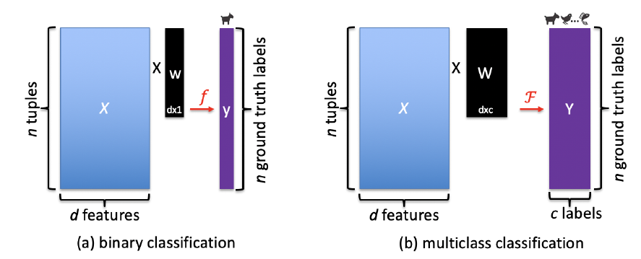
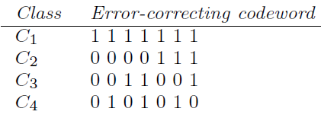
Multiclass Classification
Binary vs. multiclass classification
Methods for multiclass classification
One-versus-all (OVA): train m binary classifiers, one for each class (class j vs. the remaining)
All-versus-all (AVA): train a binary classifier for any two classes
Error-correcting coding:
Assign each class an error-correcting code
Improve the accuracy of multiclass classification
A related problem: multi-label classification (each data tuple could belong to one or more classes)

Slide 74
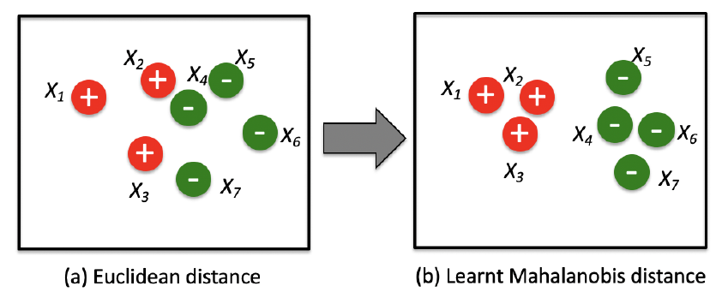
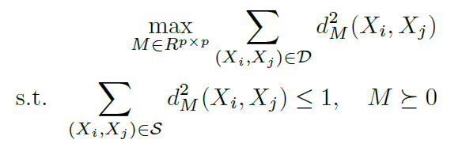
Distance Metric Learning
Setting: automatically learn the best distance metrics for a given classification task (e.g., k-nearest-neighbor classifiers).
Learning Mahalanobis distance
An example:
Detailed formulation
Intuition: (1) the distance between any pair of similar tuples in S is small and (2) the distance between any pair of dissimilar tuples in D is large
M is positive semi-definite; convex formulation

Slide 75
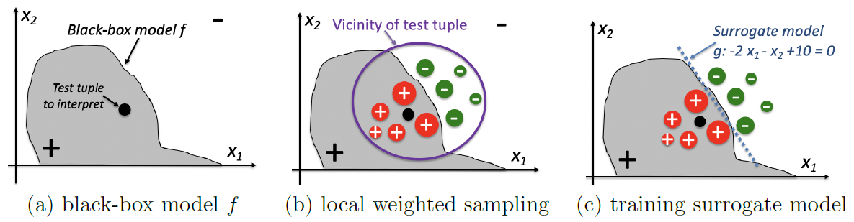
Interpretability of Classification
Setting: describes the models’ ability to explain the classification results or process in a user understandable way
Interpretability-friendly classifiers: decision tree induction, linear classifiers
LIME: local interpretable model-agnostic explanation
Key idea: train a local surrogate model (e.g., a sparse linear model) to balance the local fidelity and interpretability
Alternative approaches: counterfactual explanation, influence function

Slide 76
Genetic Algorithms
Key idea: incorporate ideas of natural evolution
General procedure:
Create an initial population consisting of random generated rules
each rule represented by a string of bits
Example: The rule: “IF A1 AND NOT A2 THEN C2 "; bit string: “100"
Form a new population based on survival of the fittest
Fitness of a rule: assessed by classification accuracy
Create offspring by genetic operators (e.g., crossover, mutation)
Evolve until a fitness threshold is satisfied for each rule in the population
Applications to data mining: evaluate the fitness of other algorithms

Slide 77
Reinforcement Learning
Relationship with classification
Classification: receives the instructive feedback (i.e., the true class label) to construct the best classifier
Reinforcement learning: receives evaluative feedback (e.g., the immediate reward of an action) to find the best action
Multi-armed bandit problem:
Setting: a slot machine with multiple arms, and each arm corresponds to an action (an advertisement on a product) with an unknown value. Find out each action to take.
Algorithms: ɛ-greedy algorithm, upper-confidence-bound method
Applications: online advertisement, robotics, chess

Slide 78
Summary
Feature Selection: Filter methods, wrapper methods and embedded methods
Bayesian Belief Networks: Probabilistic graphical model, directed acyclic graph (DAG)
Support Vector Machines: Large margin approach, kernel tricks
Pattern-Based Classification: Rule-based classification, pattern-based classification
Weakly Supervised Learning: Semi-supervised learning, active learning, transfer learning, distant supervision, zero-shot learning
Classification with Rich Data Type: Stream, sequence, and graph

Slide 79
References (1)
C. M. Bishop, Neural Networks for Pattern Recognition. Oxford University Press, 1995
C. M. Bishop, Pattern Recognition and Machine Learning. Springer, 2006
L. Breiman, J. Friedman, R. Olshen, and C. Stone. Classification and Regression Trees. Wadsworth International Group, 1984
C. J. C. Burges. A Tutorial on Support Vector Machines for Pattern Recognition. Data Mining and Knowledge Discovery, 2(2): 121-168, 1998
N. Cristianini and J. Shawe-Taylor, Introduction to Support Vector Machines and Other Kernel-Based Learning Methods, Cambridge University Press, 2000
H. Yu, J. Yang, and J. Han. Classifying large data sets using SVM with hierarchical clusters. KDD'03
A. J. Dobson. An Introduction to Generalized Linear Models. Chapman & Hall, 1990
R. O. Duda, P. E. Hart, and D. G. Stork. Pattern Classification, 2ed. John Wiley, 2001
T. Hastie, R. Tibshirani, and J. Friedman. The Elements of Statistical Learning: Data Mining, Inference, and Prediction. Springer-Verlag, 2001
S. Haykin, Neural Networks and Learning Machines, Prentice Hall, 2008
D. Heckerman, D. Geiger, and D. M. Chickering. Learning Bayesian networks: The combination of knowledge and statistical data. Machine Learning, 1995

Slide 80
References (2)
Chandrashekar, Girish, and Ferat Sahin. "A survey on feature selection methods." Computers & Electrical Engineering 40.1 (2014): 16-28.
He, Xiaofei, Deng Cai, and Partha Niyogi. "Laplacian score for feature selection." Advances in neural information processing systems. 2006.
Weston, Jason, et al. "Feature selection for SVMs." Advances in neural information processing systems. 2001.
Zhu, Xiaojin, and Andrew B. Goldberg. "Introduction to semi-supervised learning." Synthesis lectures on artificial intelligence and machine learning 3.1 (2009): 1-130.
Meyers, Chet, and Thomas B. Jones. Promoting Active Learning. Strategies for the College Classroom. Jossey-Bass Inc., Publishers, 350 Sansome Street, San Francisco, CA 94104, 1993.
Pan, Sinno Jialin, and Qiang Yang. "A survey on transfer learning." IEEE Transactions on knowledge and data engineering 22.10 (2009): 1345-1359.
Go, Alec, Richa Bhayani, and Lei Huang. "Twitter sentiment classification using distant supervision." CS224N project report, Stanford 1.12 (2009): 2009.
Socher, Richard, et al. "Zero-shot learning through cross-modal transfer." Advances in neural information processing systems. 2013.

Slide 81
References (3)
H. Cheng, X. Yan, J. Han & P. S. Yu, Direct Discriminative Pattern Mining for Effective Classification, ICDE’08.
Jingbo Shang, Wenzhu Tong, Jian Peng, and Jiawei Han, "DPClass: An Effective but Concise Discriminative Patterns-Based Classification Framework", SDM’16
D. Heckerman. A Tutorial on Learning with Bayesian Networks. In Learning in Graphical Models, M. Jordan, ed. MIT Press, 1999
Zhengzheng Xing, Jian Pei, and Eamonn J. Keogh. A brief survey on sequence classfication. SIGKDD Explor., 12(1):40{48, 2010.
Wei Wang, Vincent W. Zheng, Han Yu, and Chunyan Miao. A survey of zero-shot learning: Settings, methods, and applications. ACM Trans. Intell. Syst. Technol., 2019.
Richard S Sutton and Andrew G Barto. Reinforcement learning: An introduction. MIT press, 2018.
Marco Tulio Ribeiro, Sameer Singh, and Carlos Guestrin. why should i trust you? explaining the predictions of any classifier. KDD 2016
Alexander Ratner, Stephen H Bach, Henry Ehrenberg, Jason Fries, Sen Wu, and Christopher Re. Snorkel: Rapid training data creation with weak supervision. VLDB’17.

Slide 82
References (2): Rule and Pattern-Based Classification
H. Cheng, X. Yan, J. Han & C.-W. Hsu, Discriminative Frequent Pattern Analysis for Effective Classification, ICDE'07
H. Cheng, X. Yan, J. Han & P. S. Yu, Direct Discriminative Pattern Mining for Effective Classification, ICDE’08
W. Cohen. Fast effective rule induction. ICML'95
G. Cong, K. Tan, A. Tung & X. Xu. Mining Top-k Covering Rule Groups for Gene Expression Data, SIGMOD’05
M. Deshpande, M. Kuramochi, N. Wale & G. Karypis. Frequent Substructure-based Approaches for Classifying Chemical Compounds, TKDE’05
G. Dong & J. Li. Efficient Mining of Emerging Patterns: Discovering Trends and Differences, KDD’99
W. Fan, K. Zhang, H. Cheng, J. Gao, X. Yan, J. Han, P. S. Yu & O. Verscheure. Direct Mining of Discriminative and Essential Graphical and Itemset Features via Model-based Search Tree, KDD’08
W. Li, J. Han & J. Pei. CMAR: Accurate and Efficient Classification based on Multiple Class-association Rules, ICDM’01
B. Liu, W. Hsu & Y. Ma. Integrating Classification and Association Rule Mining, KDD’98
J. R. Quinlan and R. M. Cameron-Jones. FOIL: A midterm report. ECML’93
Jingbo Shang, Wenzhu Tong, Jian Peng, and Jiawei Han, "DPClass: An Effective but Concise Discriminative Patterns-Based Classification Framework", SDM’16
J. Wang and G. Karypis. HARMONY: Efficiently Mining the Best Rules for Classification, SDM’05
X. Yin & J. Han. CPAR: Classification Based on Predictive Association Rules, SDM’03

